Slide 1

For : PGCP DSML Date : 26th Jun 2022
Jigsaw A unext company
JPX Tokyo Stock Exchange Prediction

Slide 2
Statement of the problem :-
Building portfolios from the stocks eligible for predictions (around 2,000 stocks).
This dataset contains historic data for a variety of Japanese stocks and options.
Challenge is to predict the future returns of the stocks.
Target of the closing price (Close) between the next day and the 2 days later for each stock on each date.

Slide 3
Interdiction:-
Data Set was taken from the Kaggle competition. It is stock exchange dataset. The main aim is to, by using past and present data, predict future outcomes. In this competition they provided both historical and real time data. There are plenty of existing quantitative trading efforts used to analyse financial markets and formulate investment strategies. To create and execute such a strategy requires both historical and real-time data, which is difficult to obtain especially for retail investors. This competition will provide financial data for the Japanese market, allowing retail investors to analyse the market to the fullest extent.

Slide 4
Scope:-
As this dataset is taken from the Kaggle competition, there are plenty of different approaches that will helps understands the problem statement in better way. There is a great scope of learning different models and methods that will boosts knowledge. After gaining enough knowledge I can apply to the problem in most efficient way to predict the future outcomes.

Slide 5
Data Sets:-
financials.csv
options.csv
secondary_stock_prices.csv
stock_prices.csv
trades.csv etc.
Datasets contains 10lac records and 2000 stocks
Data Sources:- Kaggle Competition.

Slide 6
Tools used:-
Tableau
Python
Analysis:-
1st Approach: Manual calculations based on metrics
2nd Approach: Time series analysis
3rd Approach : Deep Learning Model

Slide 7
Given Compitation Metrics:-
JPX Competition Metric In this competition, the following conditions set will be used to compete for scores.
The model will use the closing price ( 𝐶(𝑘,𝑡) ) until that business day ( 𝑡 ) and other data every business day as input data for a stock ( 𝑘 ), and predict rate of change ( 𝑟(𝑘,𝑡) ) of closing price of the top 200 stocks and bottom 200 stocks on the following business day ( 𝐶(𝑘,𝑡+1) ) to next following business day ( 𝐶(𝑘,𝑡+2) )
𝑟(𝑘,𝑡)=𝐶(𝑘,𝑡+2)−𝐶(𝑘,𝑡+1)/𝐶(𝑘,𝑡+1)
Within top 200 stock predicted ( 𝑢𝑝𝑖(𝑖=1,2,…,200) ), multiply by their respective rate of change with linear weights of 2-1 for rank 1-200 and denote their sum as 𝑆𝑢𝑝 .
𝑆𝑢𝑝=∑200𝑖=1(𝑟(𝑢𝑝𝑖,𝑡)∗𝑙𝑖𝑛𝑒𝑎𝑟𝑓𝑢𝑛𝑐𝑡𝑖𝑜𝑛(2,1)𝑖))𝐴𝑣𝑒𝑟𝑎𝑔𝑒(𝑙𝑖𝑛𝑒𝑎𝑟𝑓𝑢𝑛𝑐𝑡𝑖𝑜𝑛(2,1))
Within bottom 200 stocks predicted ( 𝑑𝑜𝑤𝑛𝑖(𝑖=1,2,…,200) ), multiply by their respective rate of change with linear weights of 2-1 for bottom rank 1-200 and denote their sum as 𝑆𝑑𝑜𝑤𝑛 .
𝑆𝑑𝑜𝑤𝑛=∑200𝑖=1(𝑟(𝑑𝑜𝑤𝑛𝑖,𝑡)∗𝑙𝑖𝑛𝑒𝑎𝑟𝑓𝑢𝑛𝑐𝑡𝑖𝑜𝑛(2,1)𝑖)/𝐴𝑣𝑒𝑟𝑎𝑔𝑒(𝑙𝑖𝑛𝑒𝑎𝑟𝑓𝑢𝑛𝑐𝑡𝑖𝑜𝑛(2,1))
The result of subtracting 𝑆𝑑𝑜𝑤𝑛 from 𝑆𝑢𝑝 is 𝑅𝑑𝑎𝑦 and is called "daily spread return".
𝑅𝑑𝑎𝑦=𝑆𝑢𝑝−𝑆𝑑𝑜𝑤𝑛
The daily spread return is calculated every business day during the public/private period and obtained as a time series for that period. The mean/standard deviation of the time series of daily spread returns is used as the score. Score calculation formula (x is the business day of public/private period)
𝑆𝑐𝑜𝑟𝑒=𝐴𝑣𝑒𝑟𝑎𝑔𝑒(𝑅𝑑𝑎𝑦1−𝑑𝑎𝑦𝑥)/𝑆𝑇𝐷(𝑅𝑑𝑎𝑦1−𝑑𝑎𝑦𝑥)
The Kagger with the largest score for the private period wins.

Slide 8
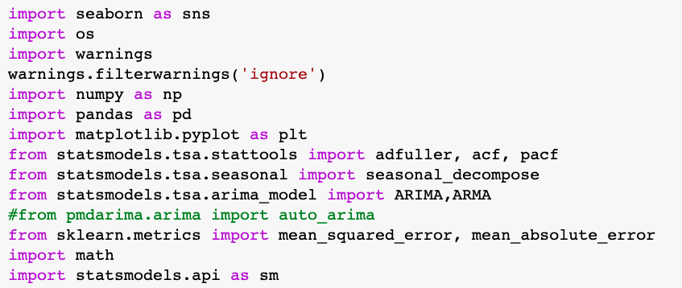
Imported the Reqired Libraries:-

Slide 9
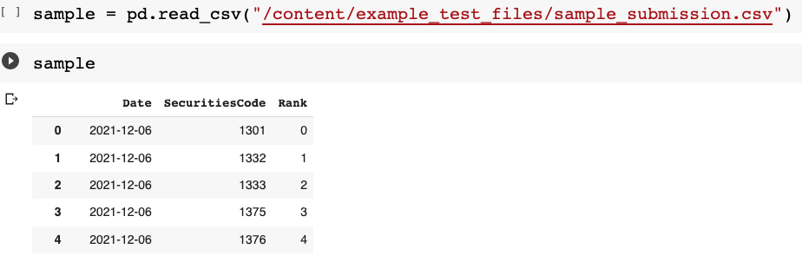
To know the what to predict we look the sample submission:-

Slide 10
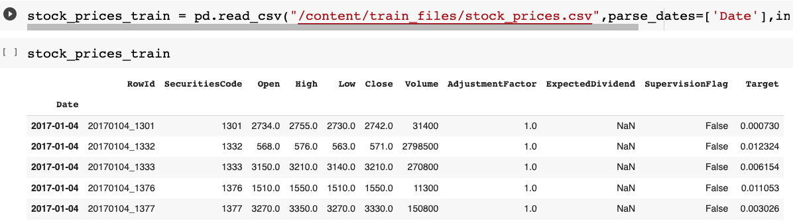
Loading Train Data

Slide 11
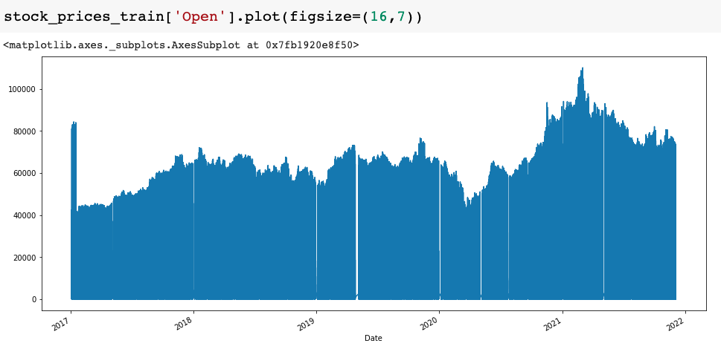
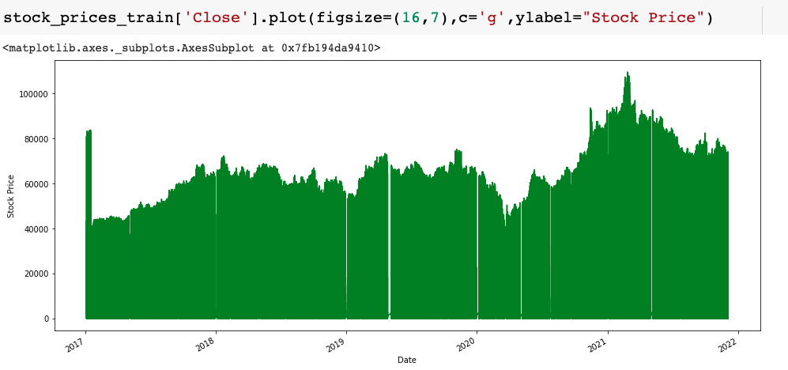
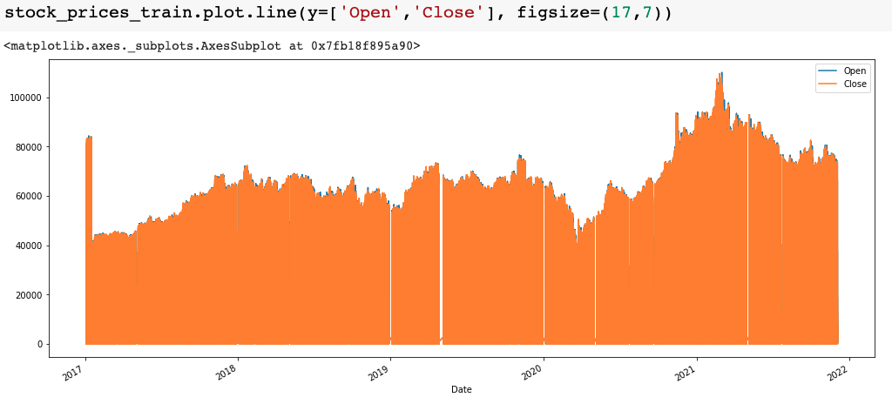
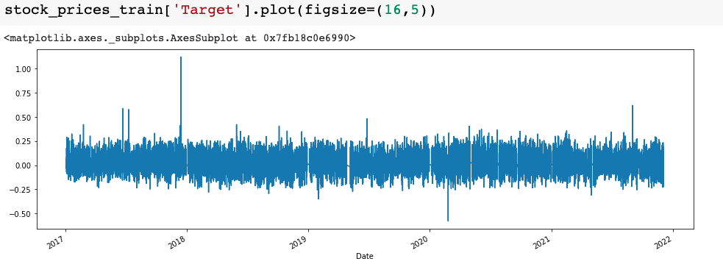
Visualization Analysis

Slide 12
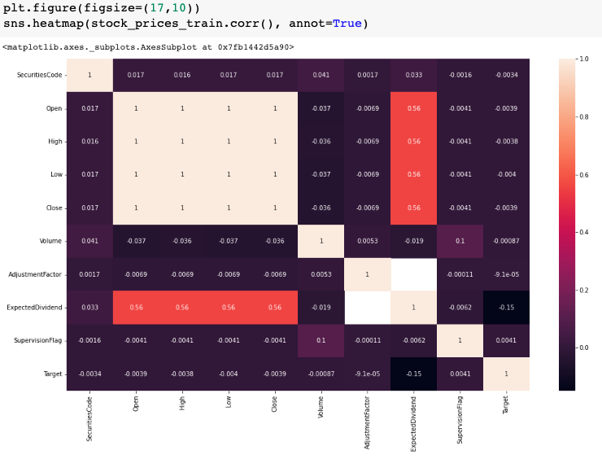
Heat Map

Slide 13
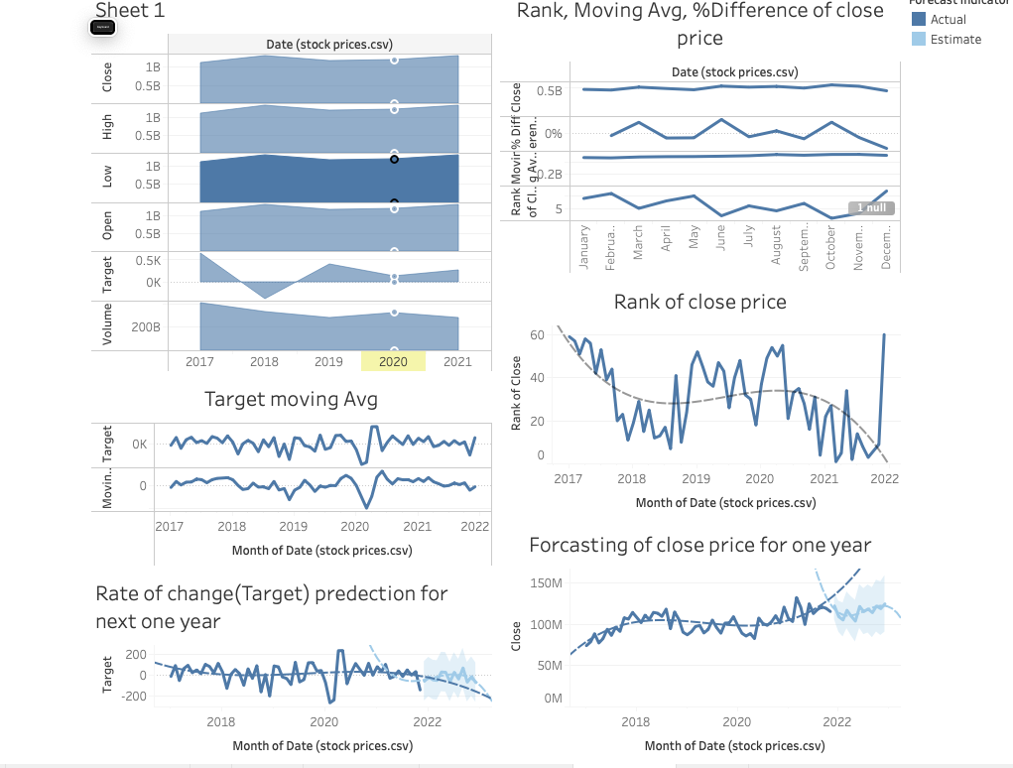
Tableau Visualization Data

Slide 14
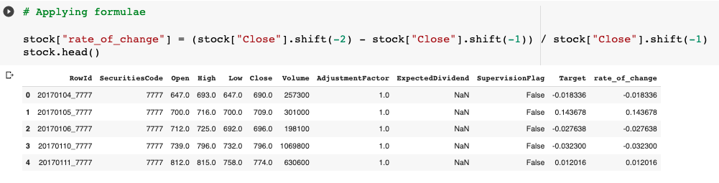
Manal Calculations
Let us try to calculate the Target(ie. rate of change) as per given formulae in metrics
𝑟(𝑘,𝑡)=(𝐶(𝑘,𝑡+2)−𝐶(𝑘,𝑡+1))/𝐶(𝑘,𝑡+1)
r = Rate of change
k = stock
t = time

Slide 15
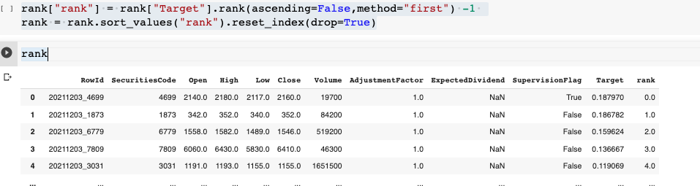
Rank Calclation

Slide 16
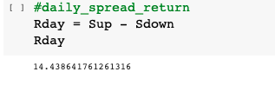
calculating the "Daily spread return”
Formulae:
𝑅𝑑𝑎𝑦 = 𝑆𝑢𝑝−𝑆𝑑𝑜𝑤𝑛
Within top 200 stock predicted ( 𝑢𝑝𝑖(𝑖=1,2,…,200) ), multiply by their respective rate of change with linear weights of 2-1 for rank 1-200 and denote their sum as 𝑆𝑢𝑝 .
𝑆𝑢𝑝 = ∑200𝑖=1(𝑟(𝑢𝑝𝑖,𝑡)∗𝑙𝑖𝑛𝑒𝑎𝑟𝑓𝑢𝑛𝑐𝑡𝑖𝑜𝑛(2,1)𝑖))/𝐴𝑣𝑒𝑟𝑎𝑔𝑒(𝑙𝑖𝑛𝑒𝑎𝑟𝑓𝑢𝑛𝑐𝑡𝑖𝑜𝑛(2,1))
Within bottom 200 stocks predicted ( 𝑑𝑜𝑤𝑛𝑖(𝑖=1,2,…,200) ), multiply by their respective rate of change with linear weights of 2-1 for bottom rank 1-200 and denote their sum as 𝑆𝑑𝑜𝑤𝑛 .
𝑆𝑑𝑜𝑤𝑛=∑200𝑖=1(𝑟(𝑑𝑜𝑤𝑛𝑖,𝑡)∗𝑙𝑖𝑛𝑒𝑎𝑟𝑓𝑢𝑛𝑐𝑡𝑖𝑜𝑛(2,1)𝑖)𝐴𝑣𝑒𝑟𝑎𝑔𝑒(𝑙𝑖𝑛𝑒𝑎𝑟𝑓𝑢𝑛𝑐𝑡𝑖𝑜𝑛(2,1))

Slide 17
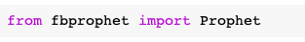
2nd Approach TimeSiries
Importing required Libraries to predict lower and upper prices

Slide 18
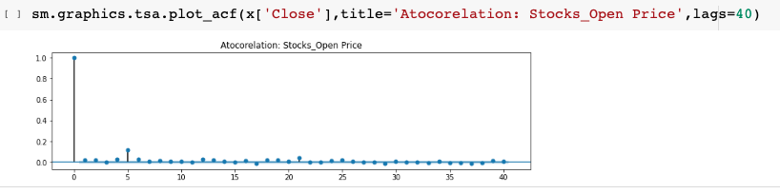
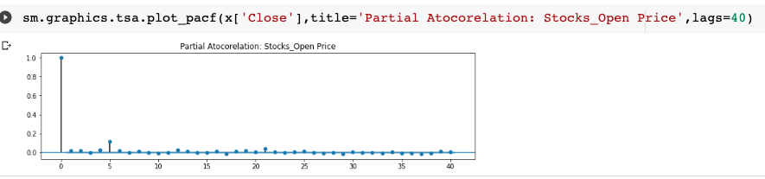
Acf and PACF Plots

Slide 19
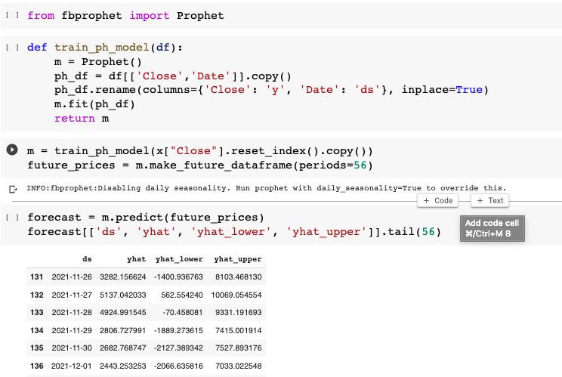
Forecasting Y lower and Y_upper

Slide 20
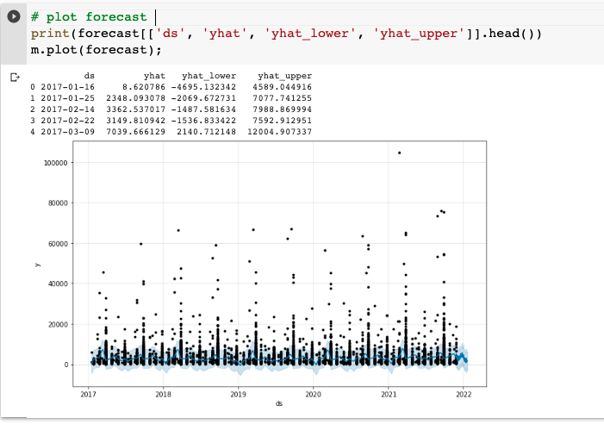
Forecasting Plot

Slide 21
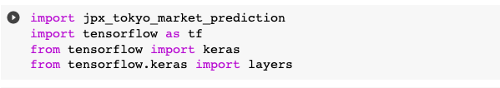
3rd Approach Neural Network model
Importing required libraries

Slide 22
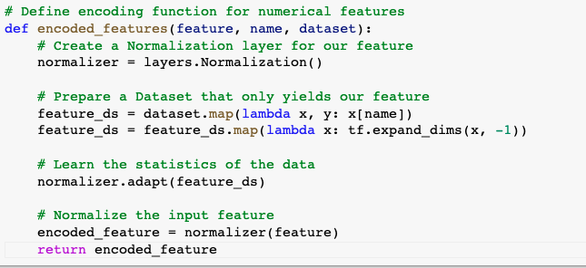
Defining a function to encode and normalize the Data

Slide 23
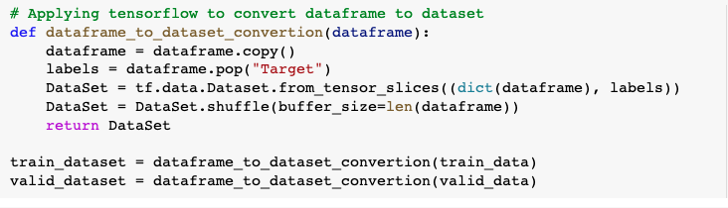
Defining a function to convert data frame to Data set by using TensorFlow

Slide 24
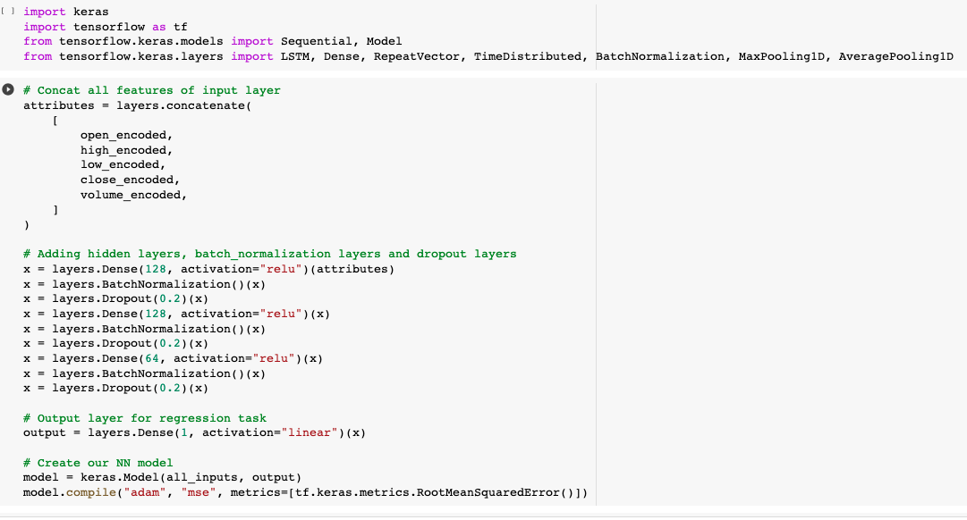
Building a model by adding required layers

Slide 25
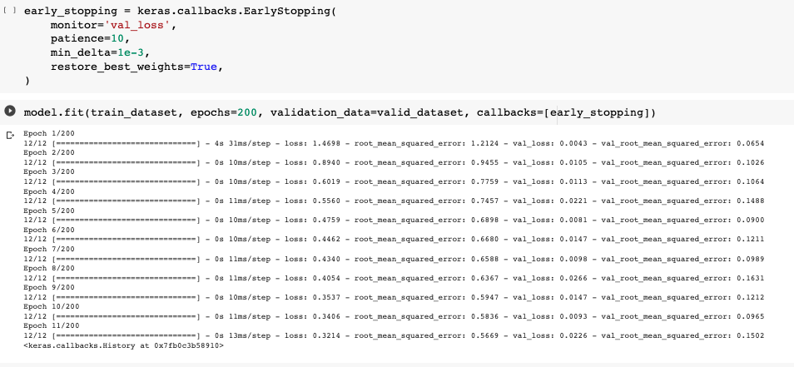
Fitting the model and Appling Callback Early Stopping

Slide 26
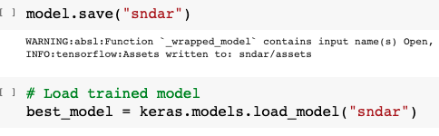
Save and Load the Model

Slide 27
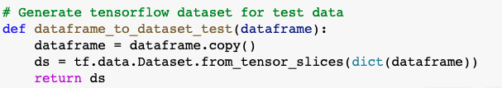
Defining a function to generate TensorFlow dataset for test_data

Slide 28
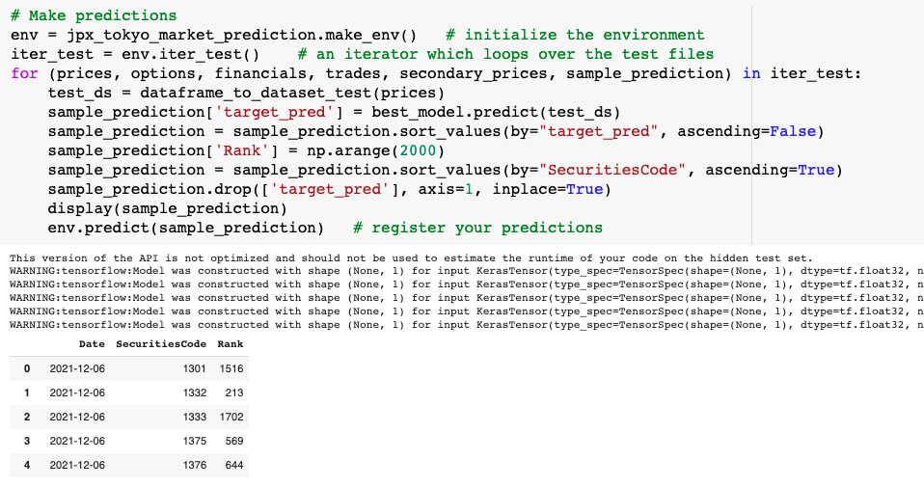
Finally predicting the Rank of stocks

Slide 29

Jigsaw A unext company
Introducing the Pantone Colour of the Year 2022. PANTONE 17-3938 Very Peri is a dynamic hue that blends the faithfulness and constancy of blue with the energy and excitement of red.
The four colour palettes in this template feature Very Peri to help you express your ideas and convey the right mood. Read on to learn how to use these colours in any presentation.
Thank You

